Slide 1
Event management system
Project by:
Prutha R. Dongre
Shivani P. Raskar

Slide 2
Project Description
The Event Management System (EMS) is a digital platform designed to streamline the planning, organization, and execution of various events. With its user-friendly interface and centralized coordination features, the EMS simplifies tasks for both event organizers and participants. By automating processes such as scheduling, venue selection, and resource allocation, the system reduces manual efforts and increases efficiency throughout the event lifecycle. Additionally, the EMS offers access to public events, allowing users to discover and participate in a diverse range of activities.
One of the unique features of the EMS is its option for rentals borrowing alongside event booking. This innovative functionality provides users with added flexibility and convenience, distinguishing the system from conventional event management solutions. By centralizing communication and coordination among people, the EMS ensures smooth event operations and enhances precision in planning and execution. Overall, the EMS aims to enhance the overall success and efficiency of events while making the experience more enjoyable for organizers and attendees alike.
In essence, the EMS revolutionizes the event management process by digitizing and centralizing tasks that were previously manual and fragmented. Through its intuitive interface and innovative features, the system simplifies event planning and coordination, making it more accessible and efficient for users. By providing a comprehensive solution that caters to the diverse needs of organizers and participants, the EMS sets a new standard for event management technology, ultimately enhancing the overall experience and success of events.

Slide 3
Scope of project:
An Event management system is a digital tool which will streamline planning, organizing and execution of various events. This user Friendly system will also provide access to public events under the tool This will help in coordinating various aspects that is scheduling, venue Selection and communication among organizers and customers and provide a centralized platforms for coordination reducing manual efforts and increasing Precision, ultimately enhancing the Overall success and efficiency of events.

Slide 4
Problem definition
The event management industry involves intricate coordination, meticulous planning, and effective communication to ensure the success of various events. However, traditional methods of organizing events often lack efficiency and face challenges in streamlining processes. To address these issues, there arises a need for an advanced digital solution - an Event Management System (EMS).

Slide 5
Problem Statement:
Organizing and managing events, ranging from corporate conferences to social gatherings, presents numerous challenges that hinder efficiency and effectiveness. Current methods rely heavily on manual coordination, fragmented communication channels, and decentralized planning, leading to inefficiencies, errors, and a lack of centralized control. The problem is further compounded by the need to cater to diverse requirements of organizers and participants, ranging from event scheduling to venue selection and equipment rentals.
Many other systems don't have flexibility for event bookings but, This Event Management System uniquely offers customers the flexibility to borrow rentals if they do not wish to book an entire event. This feature allows customers to select and rent specific equipment or resources needed for their events, enhancing flexibility and catering to diverse event requirements.
By prioritizing accessibility, precision, and user-friendliness, this system aims to revolutionize the event management industry, making event planning more efficient, enjoyable, and successful for organizers and participants alike.

Slide 6
The Event Management System stands out for its comprehensive approach to event planning, organization, and execution. It integrates multiple functionalities, including event booking, venue selection, communication tools, and rentals borrowing, into a single, user-friendly platform.
Its unique feature of offering rentals borrowing alongside event booking demonstrates its adaptability and responsiveness to customer needs, setting it apart from conventional event management solutions.

Slide 7
E-R Diagram
ER Diagram stands for Entity Relationship Diagram that displays the relationship of entity sets stored in a database.

Slide 8
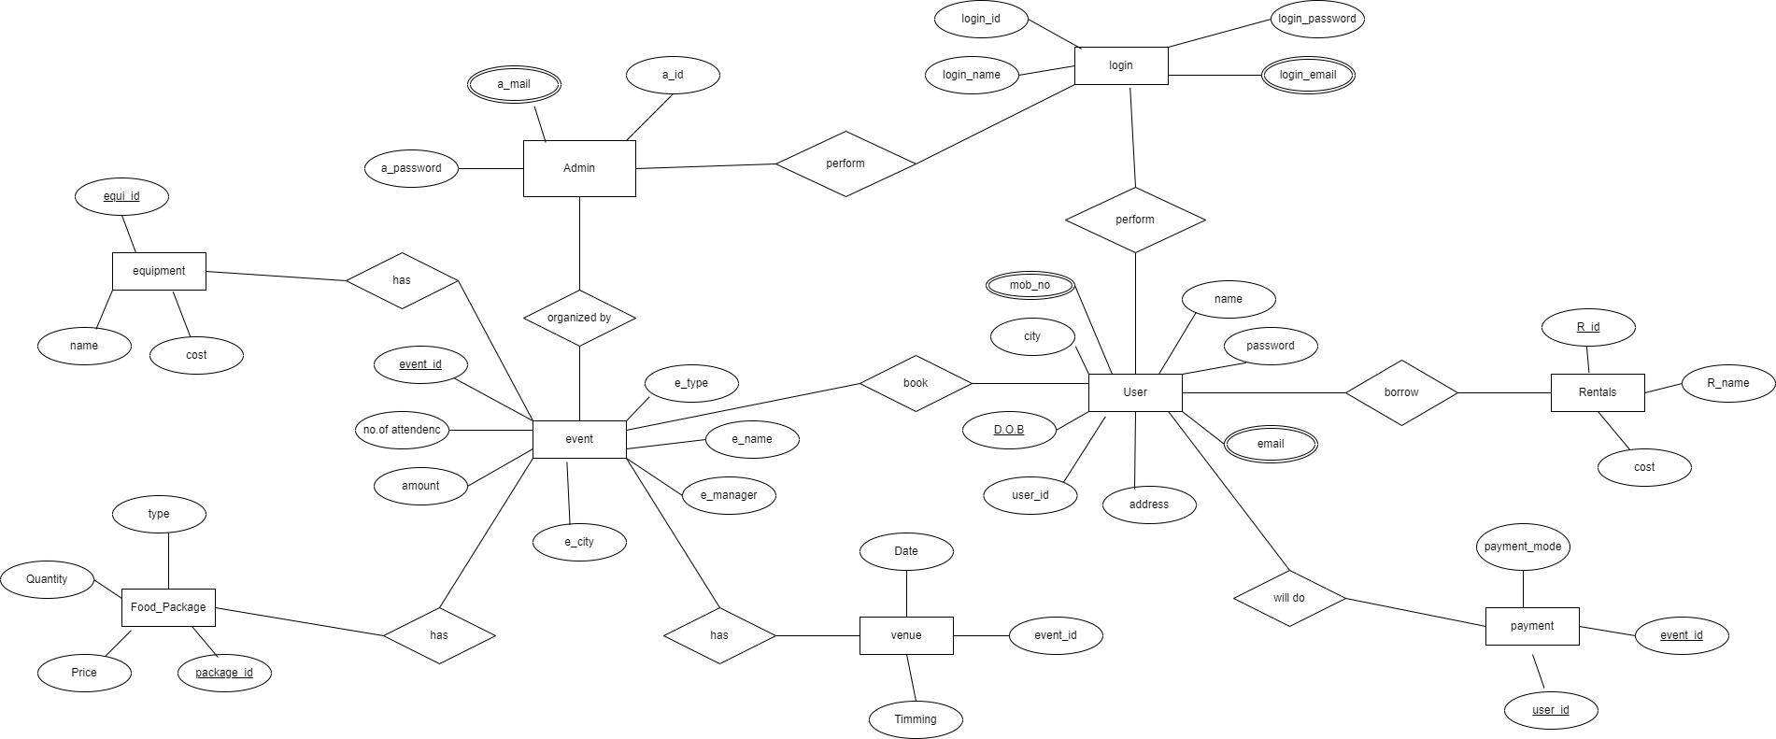

Slide 9
Database dictionary
*Admin
Field | Datatype | Description | Constraints
aid | Int | Admin’s id | Primary key
a_email | String | Admin’s email
a_pass | string | Admin’s password
*Admin

Slide 10
Database dictionary
*Login
Field | Datatype | Description | Constraints
Login_id | int | Unique login id | Primary key
Login_name | String | Login name
Login_password | string | Password
email | String | email
*Admin

Slide 11
Database dictionary
*user
field | datatype | description | Constraints
Name | string | User’s name
Email | String | User’s email
Address | String | User’s address
User_id | Int | User’s login id | Foreign key
D.O.B | Date | User’s date of birth
City | String | User’s city
Mob_no | Int | User’s mobile number
*Admin

Slide 12
Database dictionary
*event
Field | Datatype | Description | Constraints
Event_id | Int | Event id | Primary key
E_type | String | Type of event
E_name | String | Name of event
E_manager | String | Manager of event
E_city | String | City of event
Amount | Float | Amount of event
No_of_attendes | int | Number of attendes in event
*Admin

Slide 13
Database dictionary
*food package
Field | Datatype | Description | Constraints
Package_id | int | Package id of food package | Primary key
Type | String | Type of food package
Price | Float | Price of food package
quantity | Int | Quantity of food
*Admin

Slide 14
Database dictionary
*Equipment
Field | Datatype | Description | Constraints
Equi_id | int | Id of equipment | Primary key
E_name | String | Name of equipment
Cost | Float | Cost of equipment
*Admin

Slide 15
Database dictionary
*Venue
*Venue
*Admin
Field | Datatype | Description | Constraints
Date | date | Date of event
Timing | Time | Time of event
Event_id | Int | Event id | Foreign key

Slide 16
Database dictionary
*payment
*Venue
*Admin
Field | Datatype | Description | Constraints
User_id | int | Id of user | Foreign key
Payment_mode | String | Payment mode
Event_id | Int | Id of event | Foreign key

Slide 17
Database dictionary
*Rentals
*Venue
Field | Datatype | Description | Constraints
R_id | Int | Id of rental | Primary key
R_name | String | Name of rental
R_cost | float | Cost of rentals
*Admin

Slide 18
Zero Level DFD
DFD Level 0 is also called a Context Diagram. It is designed to be an at-a-glance view, showing the system as a single high-level process, with its relationship to external entities.

Slide 19
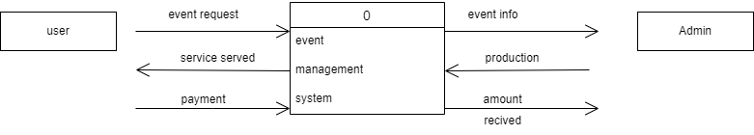

Slide 20
First Level DFD
First level DFD provides a more detailed breakout of pieces of the Context Level Diagram. The main functions carried out by the system is highlighted as we break down the high-level process of the Context Diagram into its subprocesses.

Slide 21
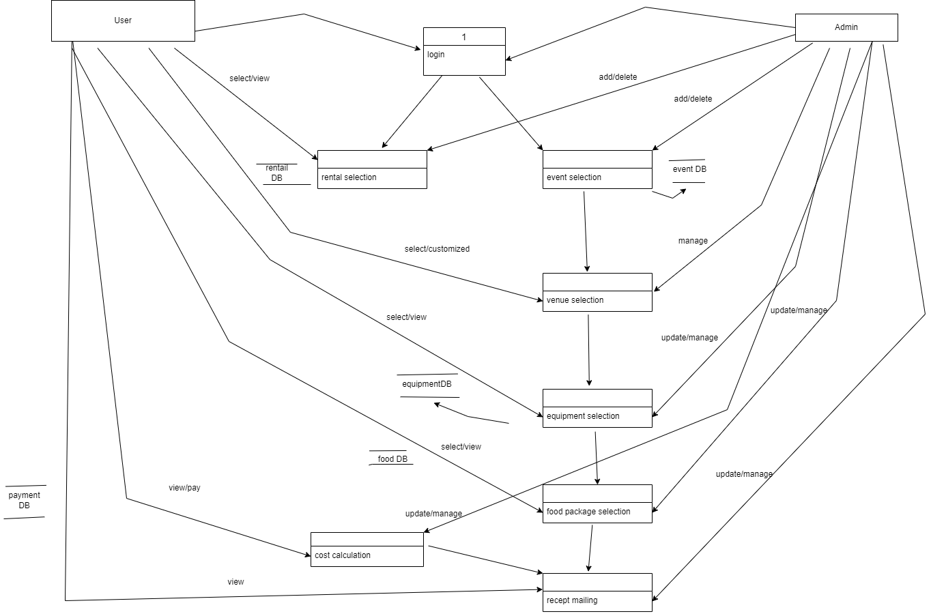

Slide 22
Class Diagram
Class diagram is not only used for visualizing, describing, and documenting different aspects of a system but also for constructing executable code of the software application.

Slide 23
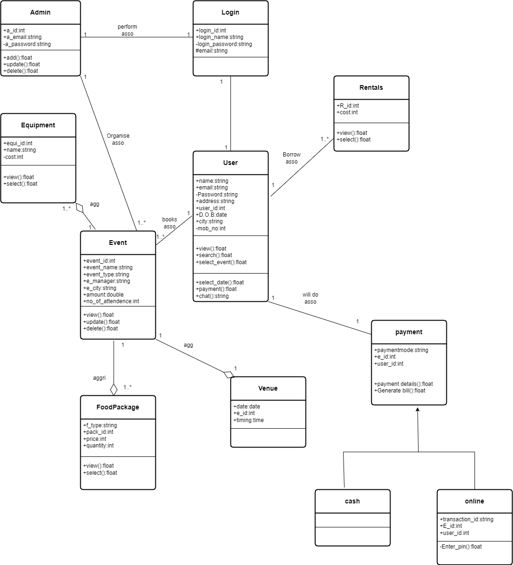

Slide 24
Object diagram
They display objects, their attributes, and the links between them, providing a snapshot of the system’s structure during execution. Since object diagrams depict behavior when objects have been instantiated, we can study the behavior of the system at a particular instant.

Slide 25
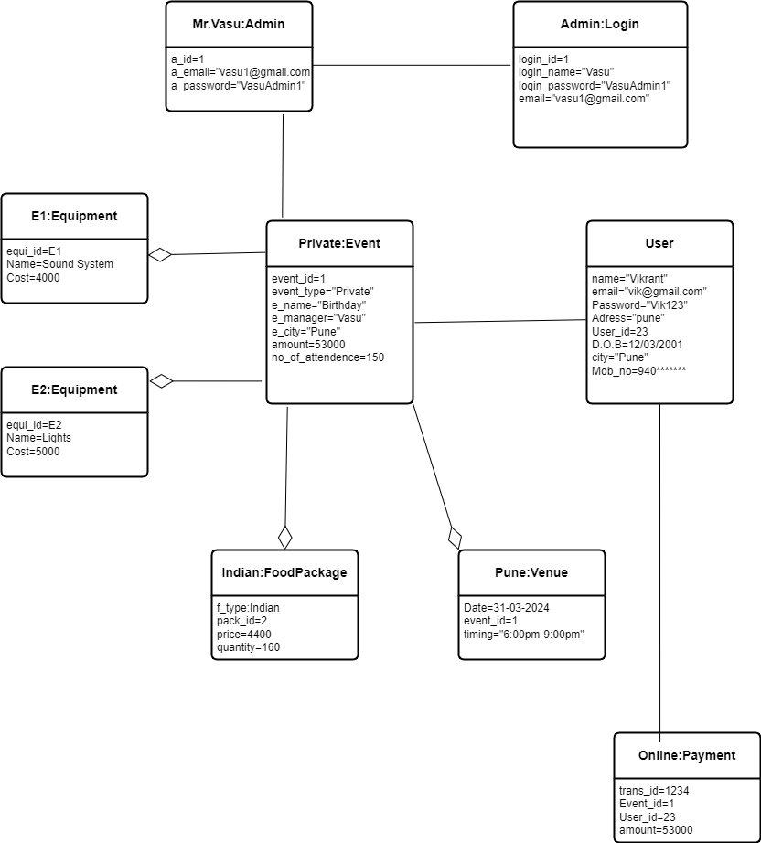
Admin-point of view

Slide 26
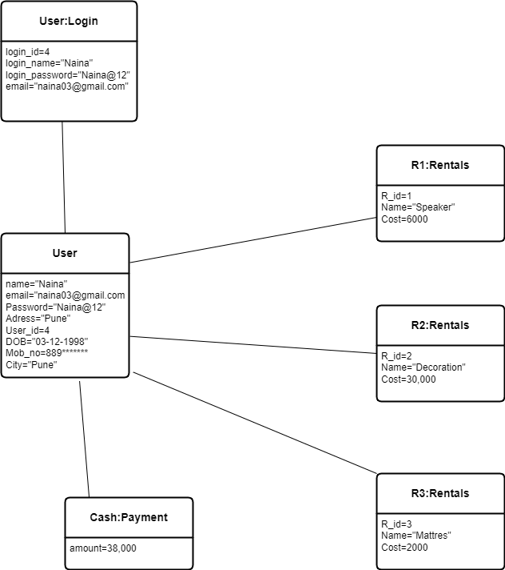
User-Point of view

Slide 27
usecase diagram
A use case diagram is a graphical depiction of a user's possible interactions with a system.

Slide 28
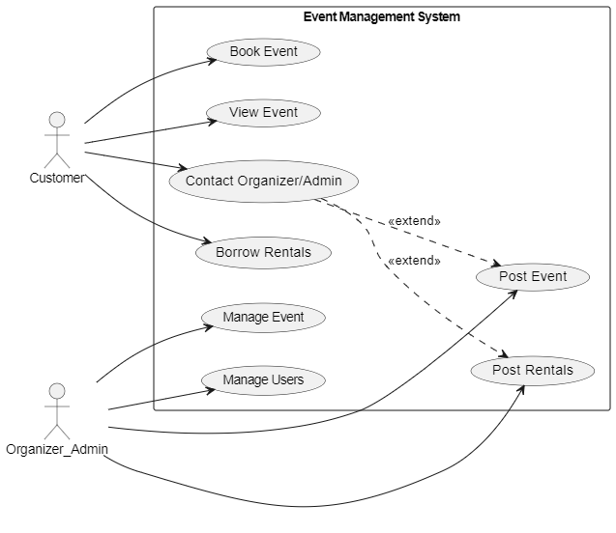

Slide 29
Sequence Diagram
A sequence diagram simply depicts interaction between objects in a sequential order i.e. the order in which these interactions take place.

Slide 30
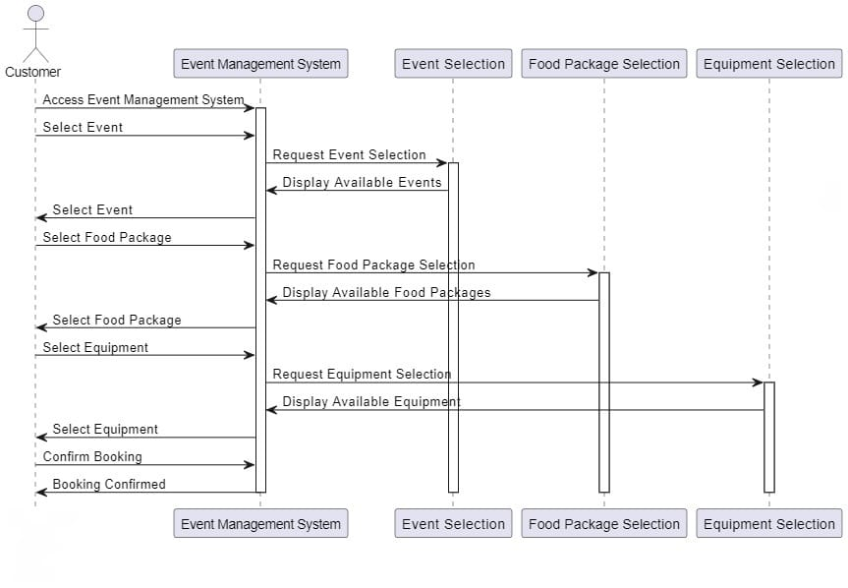

Slide 31
Activity Diagram
An activity diagram portrays the control flow from a start point to a finish point showing the various decision paths that exist while the activity is being executed.

Slide 32
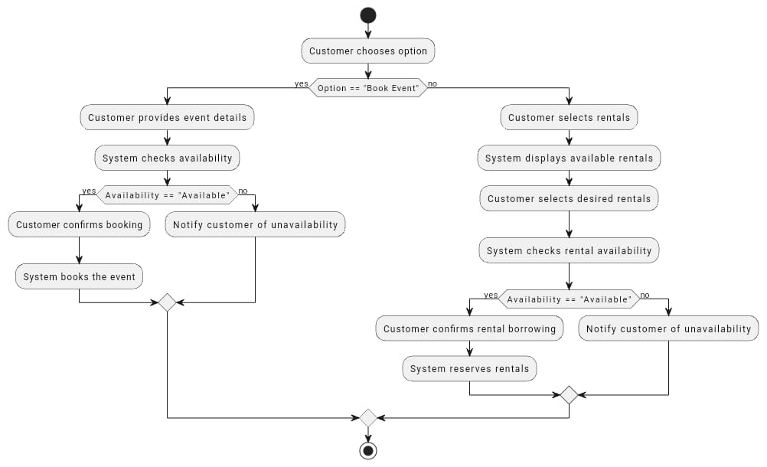

Slide 33
State Transition Diagram
The state transition diagram shows the order of states underwent by an object within the system.

Slide 34
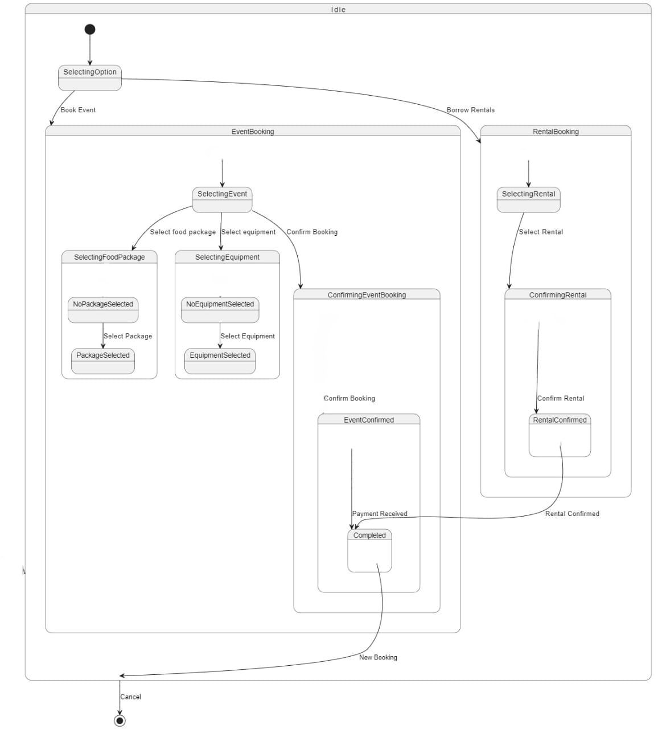

Slide 35
Component Diagram
Component diagrams are used for visualizing, specifying, and documenting component-based systems and also for constructing executable systems through forward and reverse engineering.

Slide 36
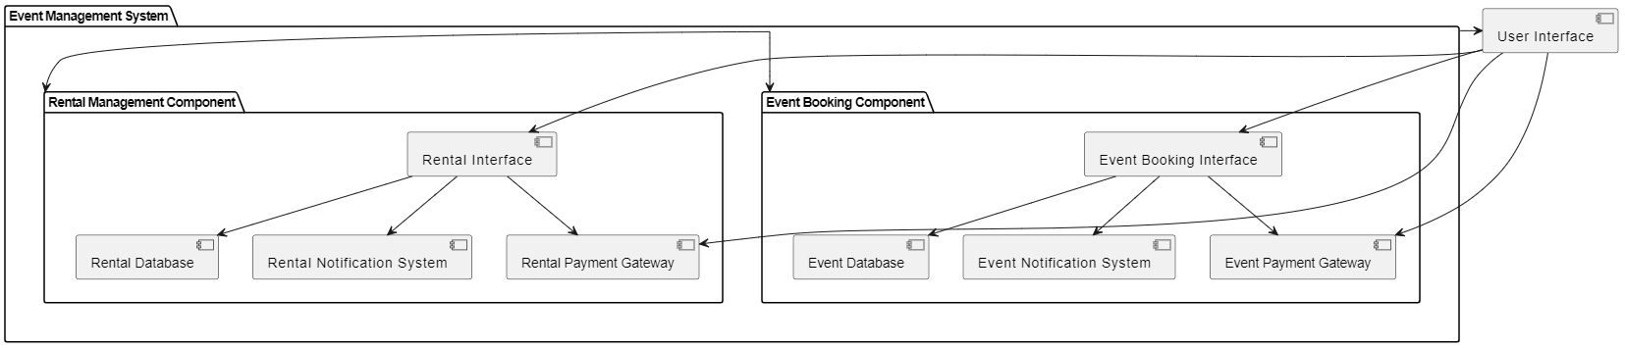

Slide 37
Deployment Diagram
Deployment diagram is a UML diagram used to visualize the physical hardware and software of a system.

Slide 38
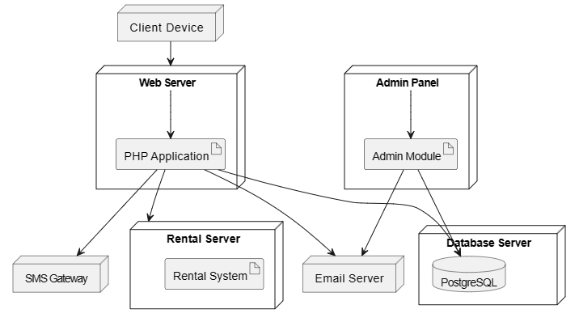
And event server
system

Slide 39
Collaboration diagram
In UML (Unified Modeling Language), a Collaboration Diagram is a type of Interaction Diagram that visualizes the interactions and relationships between objects in a system. It shows how objects collaborate to achieve a specific task or behavior.

Slide 40
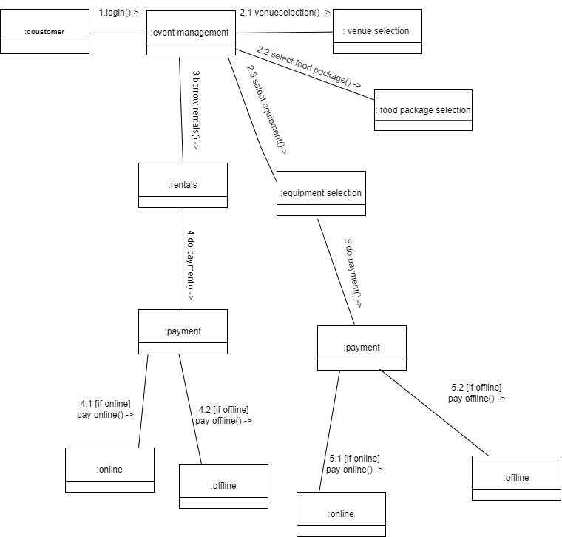

Slide 41
conclusion
Purpose of the project is that, This website will simplify the task of organizers and more efficiently communicate with participants. In essence, this event management system aims to make the entire event lifecycle more manageable efficient and enjoyable for organizers as well as attendees. Its unique feature of offering rentals borrowing alongside event booking demonstrates its adaptability and responsiveness to customer needs, setting it apart from conventional event management solutions.

Slide 42
Thank you!!!

